Slide 1
Acknowledgements
Roadmap for Prioritizing Population Groups SAGE Working Group on Covid-19 Vaccines
(endorsed by SAGE on 6 October, to be presented to WHO DG on 9 Oct)
Annelies Wilder-Smith MD PhD
With thanks to the SAGE WG, in particular to the co-chairs of the subgroup on prioritization
Ruth Faden, PhD MPH
Founding Director, Johns Hopkins Berman Institute of Bioethics
Philip Franklin Wagley Professor of Biomedical Ethics
Saad B. Omer, MBBS MPH PhD FIDSA
Director, Yale Institute for Global Health
Professor of Medicine (Infectious Diseases), Yale School of Medicine

Slide 2
Three components informing countries to formulate
the in-country vaccination strategy
SAGE
1
Provides guidance and policy advice on specific candidates, e.g. on vaccination strategies
Allocation Framework
Regulatory,
Safety & Monitoring
Countries
Sets frame for overarching public health goals and priorities
(candidate independent)
Provides guidance on regulatory issues, safety and monitoring
Responsible for final decision on in-country policy, allocation and vaccination strategy

Slide 3
WHO SAGE Policy development: steps and processes
Status update
Endorsed by SAGE and published 14 September 2020
at SAGE 6 October 2020
Values Framework for the allocation and prioritization of COVID-19 vaccination: Principles, objectives and target groups of a COVID-19 vaccination programme
Guidance on prioritization of target populations under supply constrained situations: development of use case scenarios of limited vaccine under different epidemiological settings
Policy recommendations on the use of COVID-19 vaccines once registered; under consideration of product-specific data and attributes, and with consideration of the regulatory approval process (emergency use or full registration)
Timelines depends on registration by countries or Emergency Use Listing/ prequalification by WHO; process iterative as products come along

Slide 4






Values Framework Core Principles
Human Well-Being
Global Equity
Reciprocity
Equal Respect
National Equity
Legitimacy
4

Slide 5
Principles | Objectives
Well-Being | Reduce deaths and disease burden from the COVID-19 pandemic Reduce societal and economic disruption including strategies for containing transmission, reducing severe disease and death, or some combination Protect the continuing functioning of essential services, including health services
Equal Respect | Treat the interests of all individuals and groups with equal consideration as allocation and priority-setting decisions are being taken and implemented Offer a meaningful opportunity to access vaccine to all individuals and groups who qualify for vaccine under prioritization criteria.
Global Equity | Ensure that vaccine allocation takes into account the special epidemic risks and needs of low-and middle-income countries
National Equity | Ensure that vaccine prioritization within countries takes into account the vulnerabilities, risks and needs of groups who, because of underlying societal and/or biomedical factors, are at risk of experiencing greater burdens from the COVID-19 pandemic Develop the immunization delivery systems and infrastructure required to ensure COVID-19 vaccines access to priority populations and to take proactive action to ensure equal access to everyone who qualifies under a priority group, particularly socially disadvantaged populations
Reciprocity | Protect those who bear significant additional risks and burdens of COVID-19 to safeguard the welfare of others, including healthcare and other essential workers
Legitimacy | Engage all countries in a transparent consultation process for determining what scientific, public health, and values criteria should be used to make decisions about vaccine allocation between countries Employ best available scientific evidence, expertise, and significant engagement with relevant stakeholders for vaccine prioritization between various groups within each country, using transparent, accountable, unbiased processes, to engender deserved trust in prioritization decisions
5

Slide 6
Prioritization Roadmap
To support country planning, the Roadmap suggests public health strategies and target priority groups for different levels of vaccine availability in different epidemiologic settings.
Currently available evidence is too limited to allow any recommendations for use of any specific vaccine against COVID-19 at this time, and recommendations may be affected by vaccine type (protecting against severe disease only, protecting against infection and disease), vaccine efficacy, vaccine safety
6

Slide 7



Key Assumptions
Vaccines are fully licensed and meet WHO Target Product Profiles for COVID-19 vaccines
No substantive differences in protective immune response in subpopulations
Age-dependent efficacy unlikely to change recommendations
7

Slide 8
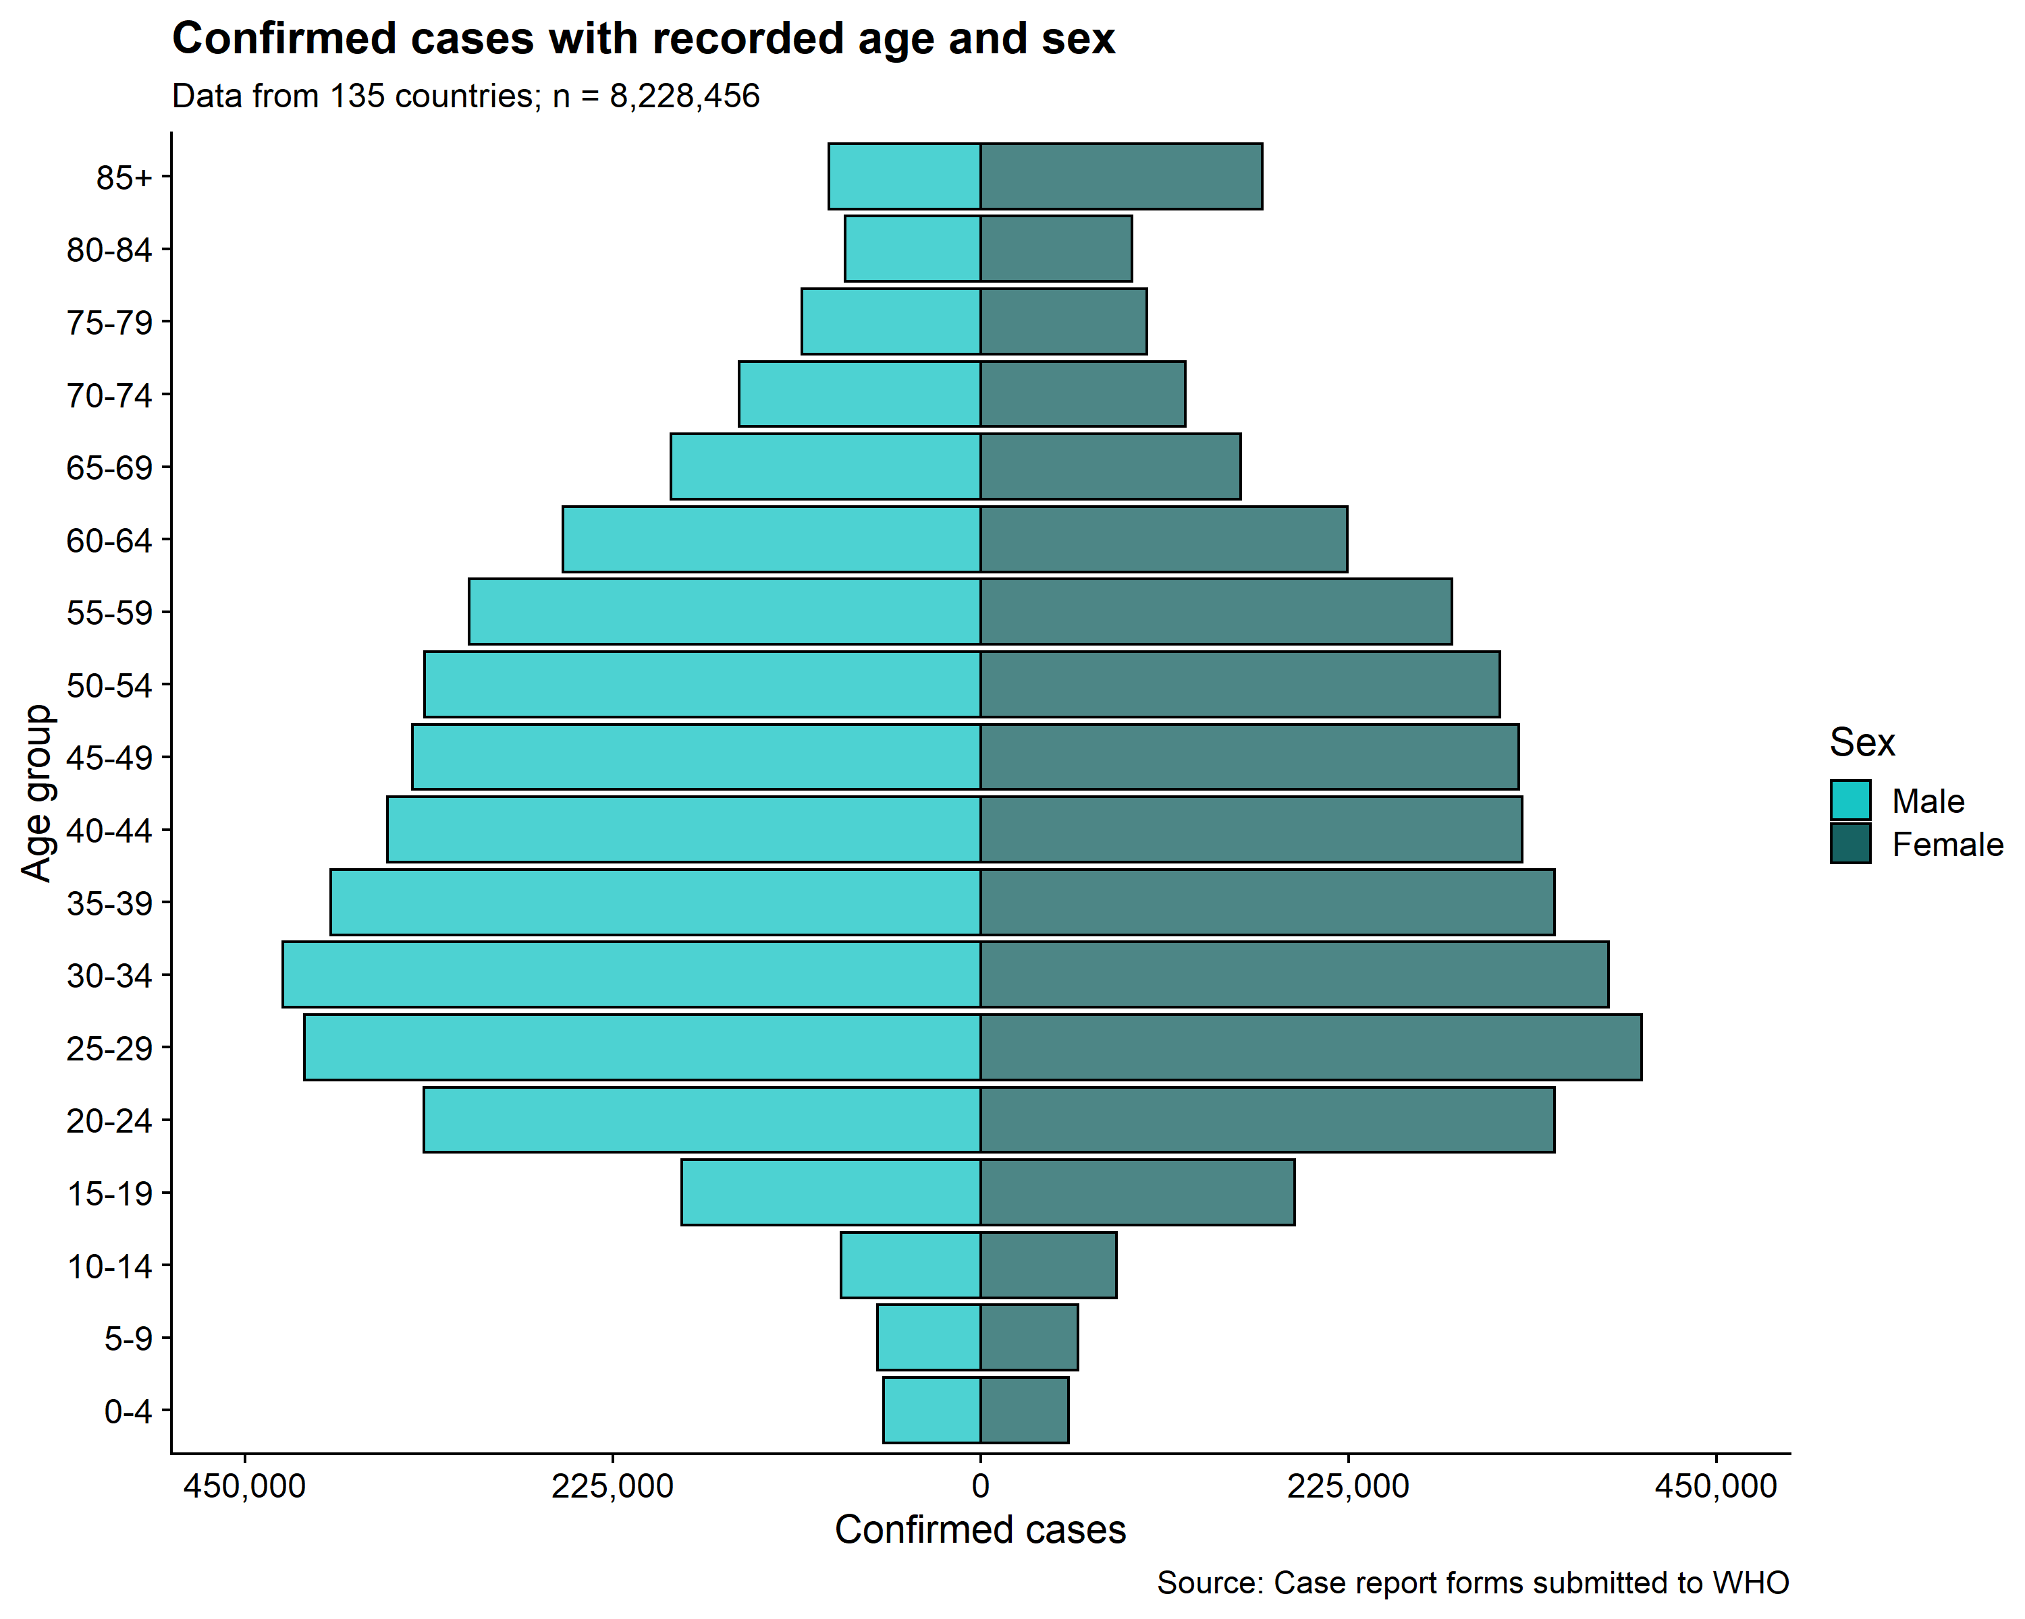
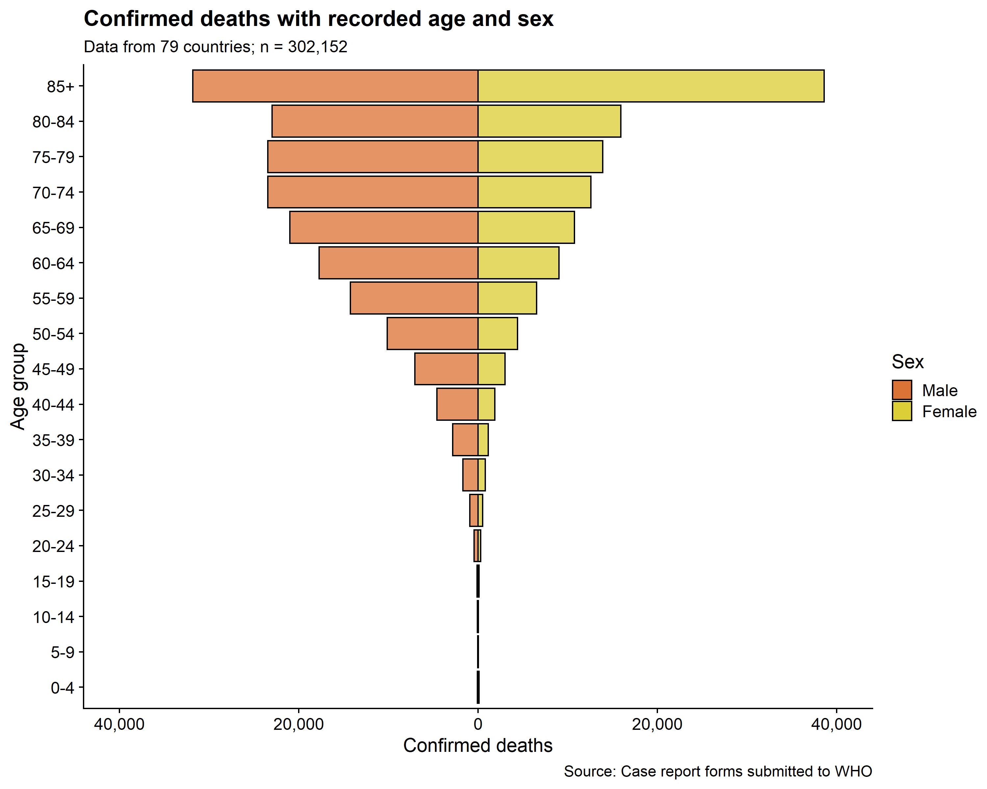
Earlier case fatality rates from case report forms submitted to WHO (left) Infection Fatality Ratio based on a Systematic Review (right) Levin, A. T., Cochran, K. B., & Walsh, S. P. (2020). Assessing the Age Specificity of Infection Fatality Rates for COVID-19: Meta-Analysis & Public Policy Implications. MedRxiv. https://doi.org/10.1101/2020.07.23.20160895
Age (years) | IFR (95% CI)
0-9 | 0.001 (0.001 - 0.001)
10-19 | 0.002 (0.002- 0.003)
20-29 | 0.008 (0.006 - 0.011)
30-39 | 0.029 (0.021 - 0.038)
40-49 | 0.098 (0.079 - 0.121)
50-59 | 0.339 (0.290 - 0.396)
60-69 | 1.17 (1.02 - 1.35)
70-79 | 4.04 (3.37 - 4.85)
80-89 | 14.0 (10.9 - 18.0)

Slide 9
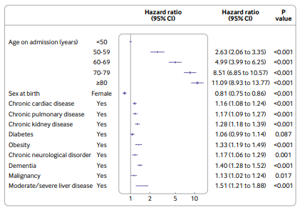
Multivariable Cox proportional hazards model (age, sex, and major comorbidities), where hazard is death.
Higher in-hospital mortality associated with:
increasing age
male sex
comorbidities (chronic cardiac disease, non-asthmatic chronic pulmonary disease, hypertension, malignancy, chronic kidney disease, liver disease, and obesity)
Discharged patients were kept in the risk set (n=15 194; No of events=3911)
ISARIC*-WHO Prospective Observational Cohort Study https://www.bmj.com/content/369/bmj.m1985

Slide 10
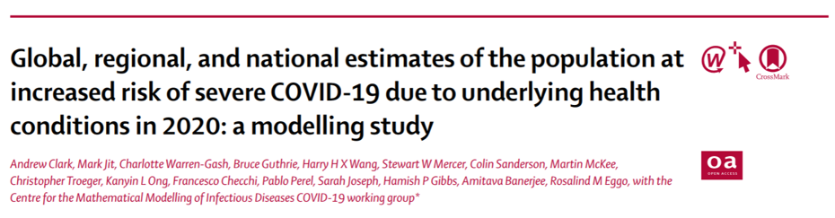
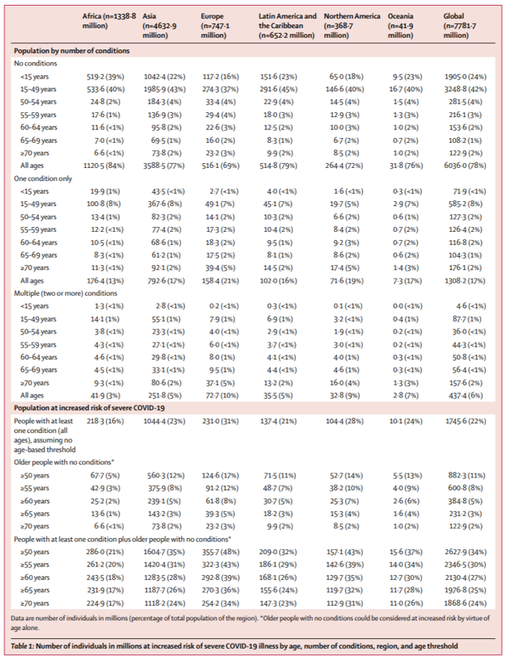
Comorbidities
Number of individuals in millions at increased risk of severe COVID-19 illness by age, number of conditions, region, and age threshold
Research considers 11 underlying conditions which confer higher COVID-19 risk based on CDC, Public Health England and WHO guidance¹
Cardiovascular disease, including cardiovascular disease caused by hypertension
Chronic kidney disease, including chronic kidney disease caused by hypertension
Chronic respiratory disease
Chronic liver disease
Diabetes
Cancers with direct immunosuppression
Cancers without direct immunosuppression, but with possible immunosuppression caused by treatment
HIV/AIDS
Tuberculosis (excluding latent infections)
Chronic neurological disorders
Sickle cell disorders
Quantification is by age (5-year age groups), sex, and country for 188 countries using prevalence data from the Global Burden of Diseases, Injuries, and Risk Factors Study (GBD) 2017 and UN population estimates for 2020

Slide 11
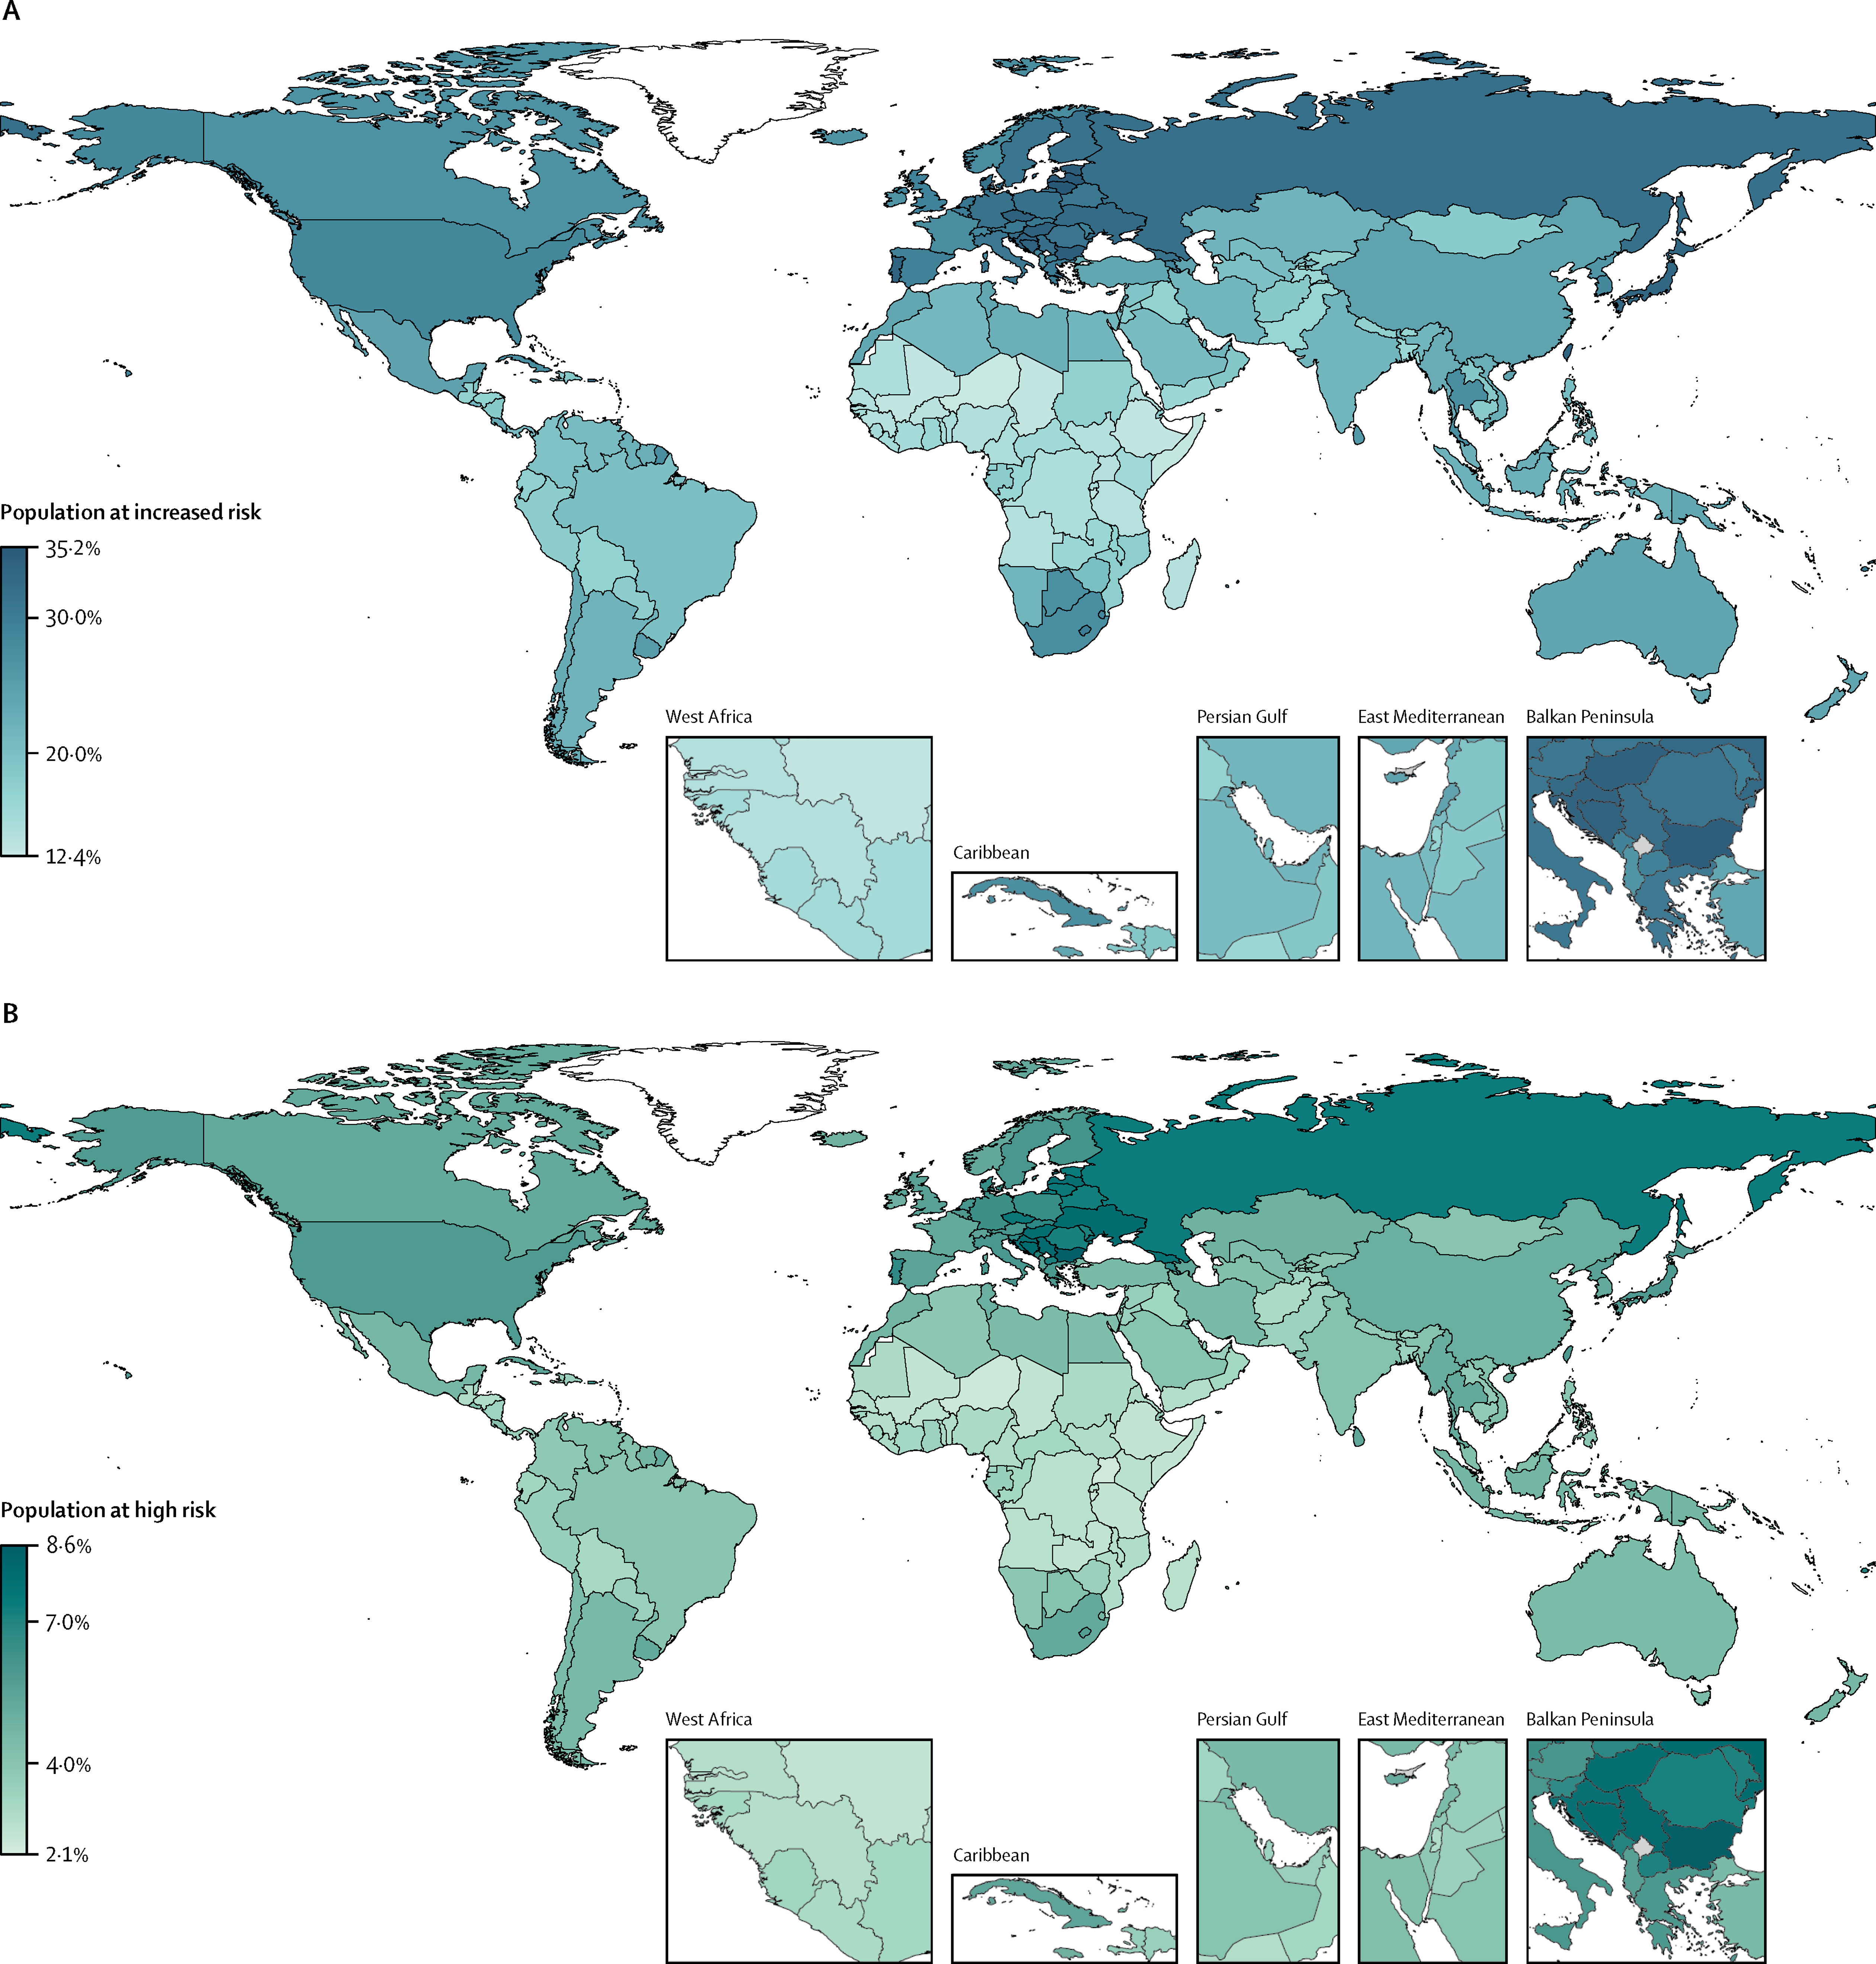
Proportion of population at increased risk and high risk of severe COVID-19 by country
Figure 4
The Lancet Global Health 2020 8e1003-e1017DOI: (10.1016/S2214-109X(20)30264-3)
Notes:
Proportion of population at increased risk and high risk of severe COVID-19 by country
For age-standardised estimates, see appendix (p 16).

Slide 12
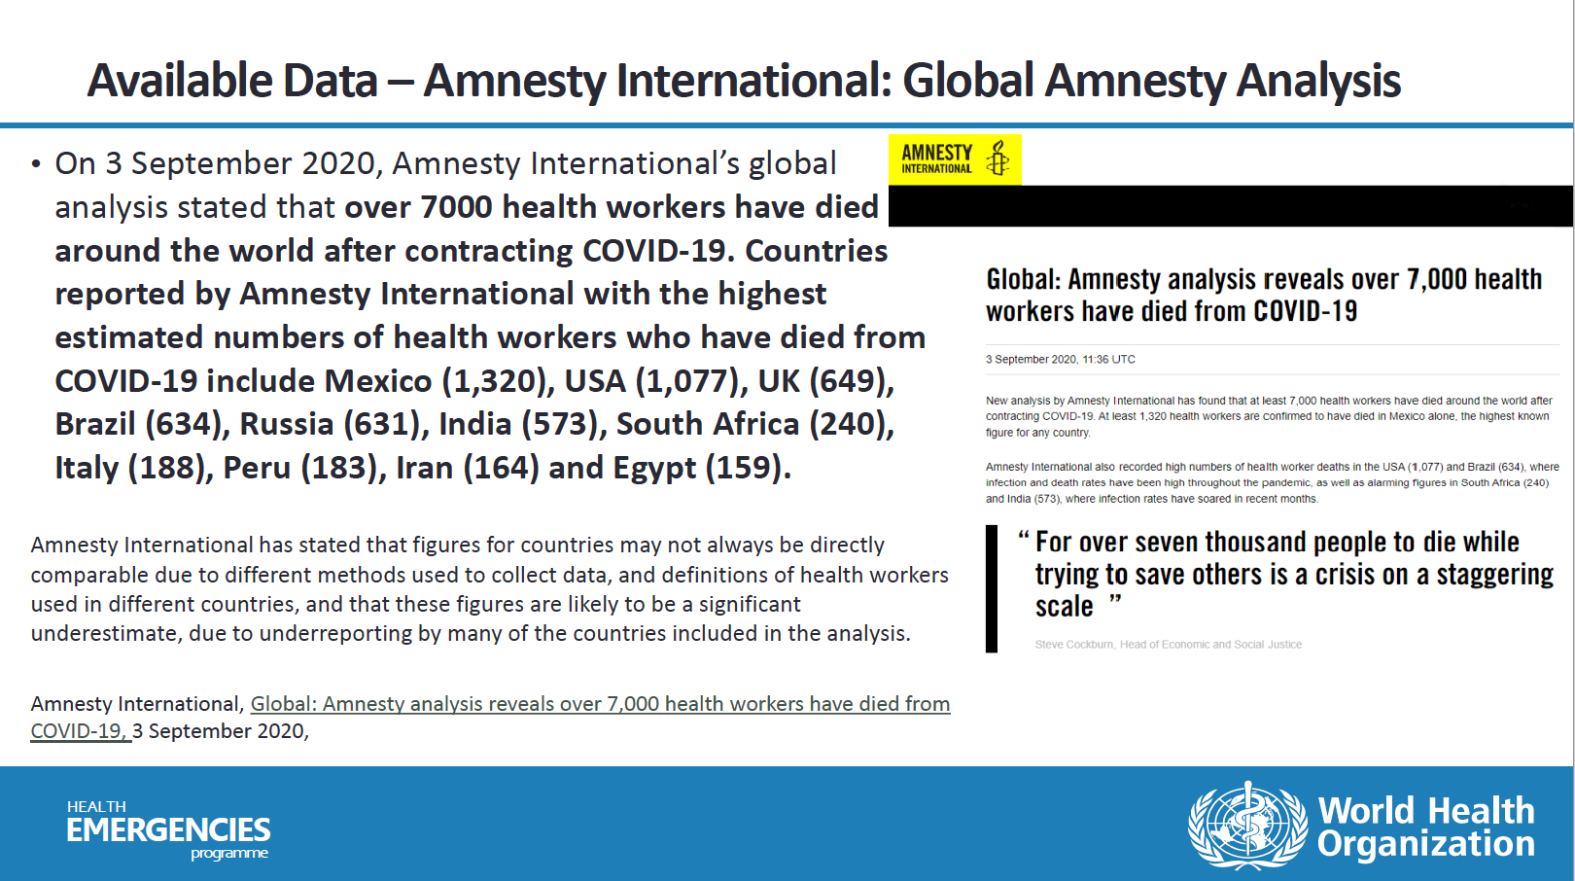

Slide 13



Prioritization Dimensions
Overall Public Health Strategy
Epidemiologic Scenario
Vaccine Supply Scenarios
10

Slide 14




Epidemiologic Scenarios
Community Transmission
Sporadic Cases or Clusters of Cases
No Cases
11

Slide 15
Community Transmission
Overall Public Health Strategy
Initial focus on direct reduction of morbidity and mortality and maintenance of most critical essential services; also, reciprocity.
Expand to reduction in transmission to further reduce disruption of social and economic functions.
12

Slide 16

Sporadic Cases or Clusters of Cases
Overall Public Health Strategy
Initial focus on direct reduction of morbidity and mortality and maintenance of most critical essential services; also, reciprocity.
Expand to substantially control transmission and minimize disruption of social and economic functions.
14

Slide 17
No Cases
Overall Public Health Strategy
Initial focus on prevention of community transmission; also, reciprocity.
Expand to preserve control of transmission and reduce reliance on most burdensome non-pharmaceutical interventions, as well as to protect highest risk individuals in the event of importation-associated outbreaks.
15
Notes:
UPDATE PUBLIC HEALTH STRATEGY

Slide 18
Vaccine Supply Scenarios
Stage I (very limited availability, 1-10%)
Stage II (limited availability, 11-20%)
Stage III (moderate availability, 21-50%)
Ia
Ib
II
III
16

Slide 19

How Supply Staging of Priority Groups Relates to Population Size
Groups are staged sequentially.
Groups within stages are not rank ordered.
(with the exception of Stages Ia and Ib)
In some countries, the amount of vaccine for a vaccine supply stage may be insufficient.
These instances will require within-stage prioritization by countries.
Ia
Ib
II
III
18

Slide 20

How Supply Staging of Priority Groups Relates to Population Size
Groups are staged sequentially.
Groups within stages are not rank ordered.
(with the exception of Stages Ia and Ib)
In some countries, the amount of vaccine for a vaccine supply stage may be insufficient.
These instances will require within-stage prioritization by countries.
Ia
Ib
II
III
19

Slide 21
Epidemiologic Setting Scenario: Community Transmission Overall public health strategy for epidemiologic setting: Initial focus on direct reduction of morbidity and mortality and maintenance of most critical essential services; also, reciprocity. Expand to reduction in transmission to further reduce disruption of social and economic functions. (A1) (A2) (A3) (B1) (B2) (C1) (D1)
Vaccine supply scenario | Priority populations
Stage I (very limited vaccine availability, ranging from 1-10%) | Stage Ia (Initial Launch) - Health workers at high to very high risk of acquiring and transmitting infection (A1) (A3) (D1) Stage Ib - Older adults defined by age-based risk specific to country/region, specific age cut-off to be decided at the country level (A1) (C1)
Stage II (limited vaccine availability, ranging from 11-20%) | - Older adults not covered in Stage I (A1) (C1) - Individuals with comorbidities or health states determined to be at significantly higher risk of severe disease or death. (A1) (C1) - Sociodemographic groups at significantly higher risk of severe disease or death (A1) (B1) (B2) (C1) - Health workers engaged in immunization delivery (routine programme-specific and COVID-19) (A1) (A2) (B2) (C1) (C2) (D1) - High priority teachers and school staff (A2) (A3) (B1) (C1)
Stage III (moderate vaccine availability, ranging from 21-50%) | - Remaining teachers and school staff (A2) (A3) (B1) (C1) - Other essential workers outside health and education sectors (A2) (A3) (D1) - Pregnant women (see accompanying text on pregnant women) (A1) (B1) (B2) (C1) - Health workers at low to moderate risk of acquiring and transmitting infection (A1) (A3) (D1) - Personnel needed for vaccine production and other high-risk lab staff (A1) (A2) (A3) (D1) - Social/employment groups at elevated risk of acquiring and transmitting infection because they are unable to effectively physically distance (A1) (B1) (B2) (C1)
20

Slide 22
Epidemiologic Setting Scenario: Sporadic Cases or Clusters of Cases Overall public health strategy for epidemiologic setting: Initial focus on direct reduction of morbidity and mortality and maintenance of most critical essential services; also, reciprocity. Expand to substantially control transmission and minimize disruption of social and economic functions. (A1) (A2) (A3) (B1) (B2) (C1) (D1)
Vaccine supply scenario | Priority populations
Stage I (very limited vaccine availability, ranging from 1-10%) | - Health workers at high to very high risk of acquiring and transmitting infection in areas with high transmission or anticipated high transmission (A1) (A3) (D1) - Older adults defined by age-based risk specific to country/region, specific age cut-off to be decided at the country level, in areas with high transmission or anticipated high transmission (A1) (C1) - Emergency reserve of vaccines for utilization for outbreak response or mitigation (e.g. severe localized outbreak) (A1) (A2)
Stage II (limited vaccine availability, ranging from 11-20%) | - Health workers at high to very high risk of acquiring and transmitting infection as defined by interim guidance forthcoming from WHO, in the rest of the country (A1) (A3) (D1) - Older adults defined by age-based risk specific to country/region, specific age cut-off to be decided at the country level, in the rest of the country (A1) (C1) - Groups with comorbidities or health states determined to be at significantly higher risk of severe disease or death in areas with high transmission or anticipated high transmission (in countries where the relevant comorbidities can be equitably assessed across the population) (A1) (C1) - Sociodemographic groups at significantly higher risk of severe disease or death in areas with high transmission or anticipated high transmission (A1) (B1) (B2) (C1)
Stage III (moderate vaccine availability, ranging from 21-50%) | - Primary and secondary teachers and school staff in areas with high transmission or anticipated high transmission (A2) (A3) (B1) (C1) - Other essential workers outside health and education sectors in areas with high transmission or anticipated high transmission (A2) (A3) (D1) - Social/employment groups at elevated risk of acquiring and transmitting infection because they are unable to effectively physically distance in areas with high transmission or anticipated high transmission (A1) (B1) (B2) (C1) - Health workers at low to moderate risk of acquiring and transmitting infection as defined by interim guidance forthcoming from WHO throughout the country (A1) (A3) (D1) - Age groups at high risk of transmitting infection in the rest of the country (A1) (A2) - Personnel needed for vaccine production and other high-risk lab staff (A1) (A2) (A3) (D1) - Pregnant women (see accompanying text on pregnant women) (A1) (B1) (B2) (C1)
21

Slide 23
TABLE 2 Summary Table of the Application of the Roadmap Under Various Contingencies. Adapted from National Academies of Sciences, Engineering, and Medicine’s Framework for Equitable Allocation of COVID-19 Vaccine.
Contingency | Change in the Application of the Roadmap
Fewer vaccine courses available than expected | The Roadmap is unchanged. Some individuals receive vaccination later than they would otherwise.
Vaccine requires two doses, rather than one | The Roadmap is unchanged, but some individuals receive vaccination later.
Low vaccine efficacy among older adults or other population subgroup | Current modelling suggests that (given the many-fold higher mortality rate among older individuals) age-dependent vaccine efficacy would not significantly change the recommendations for priority use cases in older populations). If vaccine efficacy in older adults relative to other age groups was so low that the prioritization of older adults was expected to lead to substantially worse overall outcomes in number of lives saved, the older age group individuals in each scenario would likely be moved to a lower rank. Similar considerations apply for individuals with comorbidities.
Low vaccine efficacy in preventing transmission | The importance of high coverage of the most vulnerable groups is increased.
Unanticipated vaccine adverse events | Only prioritize individuals or groups for whom vaccine benefits continue to outweigh the risks.
Vaccine acceptance and uptake is lower than expected | The Roadmap is unchanged. The community engagement and risk communication are enhanced.
More than one vaccine type available | The Roadmap is unchanged, but which vaccines are allocated to which population groups must take into account the benefits and risks of the vaccine for each population group. As authorized vaccines become available, SAGE will make vaccine-specific recommendations.
Epidemic spread is continuing when the vaccine becomes available | The Roadmap is unchanged. Public health messages must continue to stress the need for personal protective measures (e.g., masks, social distancing, hand washing, ventilation).
Risk profile of a previously identified high-risk group changes (e.g. due to high infection rate in earlier waves) | The general structure of the Roadmap is unchanged. The relevant consideration is high-risk, and if a group is no longer high-risk it should be lowered in priority. However, due to equity concerns, many of these groups are likely to be disadvantaged, the evidentiary basis for any change in priority status must be high and the burden of proof should be on the immunization programme/government to meet.
Some countries mandate vaccination of select groups | The Roadmap is unchanged, but countries mandating vaccination of select groups might allocate the vaccine in a manner different from the Roadmap.
Some employers require proof of vaccination | The Roadmap is unchanged, but such requirements could change rates of vaccine uptake, and would pose hazards for those individuals for whom the vaccine is medically contraindicated and could raise issues around discrimination against those unable to obtain the vaccine and therefore unable to work.
Some countries do not provide free vaccine access to non-citizens or people without documentation of legal status | The Roadmap is unchanged. This practice violates the principle of equity and the goals of public health. However, in such cases, other sources of financial support (e.g. philanthropy, civil society organizations, pharmaceutical companies) should be sought to provide vaccination for those individuals.
23
Notes:
Table 2

Slide 24
Legend: Translating Objectives to Priority Groups
A. Human Well-Being | A1. Reduce deaths and disease burden from the COVID-19 pandemic
 | A2. Reduce societal and economic disruption (other than through reducing deaths and disease burden)
 | A3. Protect the continuing functioning of essential services, including health services
B. Equal Respect | B1. Treat the interests of all individuals and groups with equal consideration as allocation and priority-setting decisions are being taken and implemented
 | B2. Offer a meaningful opportunity to be vaccinated to all individuals and groups who qualify under prioritization criteria
C. National Equity | C1. Ensure that vaccine prioritization within countries takes into account the vulnerabilities, risks and needs of groups who, because of underlying societal, geographic or biomedical factors, are at risk of experiencing greater burdens from the COVID-19 pandemic
 | C2. Develop the immunization delivery systems and infrastructure required to ensure COVID-19 vaccines access to priority populations and take proactive action to ensure equal access to everyone who qualifies under a priority group, particularly socially disadvantaged populations
D. Reciprocity | D1. Protect those who bear significant additional risks and burdens of COVID-19 to safeguard the welfare of others, including health and other essential workers
24

Slide 25

National Equity Considerations
Ensure that vaccine prioritization within countries takes into account the vulnerabilities, risks and needs of groups who, because of underlying societal, ethnic/racial, geographic or biomedical factors, are at risk of experiencing greater burdens from the COVID-19 pandemic.
25

Slide 26
Thank you

Slide 27
Additional slides

Slide 28
Epidemiologic Setting Scenario: No Cases Overall public health strategy for epidemiologic setting: Initial focus on prevention of community transmission; also, reciprocity. Expand to preserve control of transmission and reduce reliance on most burdensome non-pharmaceutical interventions, as well as to protect highest risk individuals in the event of importation-associated outbreaks. (A1) (A2) (A3) (B1) (C1) (D1)
Vaccine supply scenario | Priority populations
Stage I (very limited vaccine availability, ranging from 1-10%) | - Health workers at high to very high risk of acquiring and transmitting infection as defined by interim guidance forthcoming from WHO (A1) (A3) (D1) - Essential travellers at risk for acquiring infection outside the home country and reintroducing infection upon return to home country (e.g. students, business travellers, migrant workers, aid workers). Countries should define essential travellers in a way that constrains the ability of economically and politically powerful individuals to exploit this priority group to their advantage. (A1) (A2) (A3) - Border protection staff screening for imported cases and workers for outbreak management (e.g. isolation and quarantine managers, immunization deployment staff) (A1) (A2) (D1) - Emergency reserve utilization for focused outbreak response (e.g. importation outbreaks) (A1) (A2)
Stage II (limited vaccine availability, ranging from 11-20%) | - Health workers at low to moderate risk of acquiring and transmitting infection as defined by interim guidance forthcoming from WHO (A1) (A3) (D1) - All travellers at risk for acquiring infection outside the home country and reintroducing infection upon return to home country (A1) (A2) - Emergency reserve of vaccines utilization for outbreak mitigation (e.g. importation outbreaks) (A1) (A2)
Stage III (moderate vaccine availability, ranging from 21-50%) | - Older adults defined by age-based risk specific to country/region, specific age cut-off to be decided at the country level (A1) (C1) - Age groups at high risk of transmitting infection (A1) (A2) - Primary and secondary teachers and school staff (A2) (A3) (B1) (C1) - Other essential workers outside health and education sectors (A2) (A3) (D1)
22

Slide 29
Allocation Framework and Allocation Mechanism for Vaccines based on extensive country input
Goals
Protect public health and minimize societal and economic impact by reducing COVID-19 mortality
Further priority groups
High-risk adults
Participants receive doses to cover more than 20% of their population.
This would cover additional priority populations.
Priorities
Health and social care workers
All participants receive additional doses beyond the 3% to total 20% of their population (in tranches).
This could include the elderly, adults with comorbidities or others depending on locally relevant risk factors
All participants receive doses to cover 3% of their population.
This would be enough to cover all workers involved in health and social care work.
If protracted severe supply constraints remain, timing is based on participants’ vulnerability and COVID-19 threat
Participants receive doses proportionally to their total population*
Timing
A buffer will also be set aside for emergency deployment based on immediate needs
Note: The fundamental principle applies that all participants receive doses at the same rate to the extent possible, notwithstanding likely practical limitations to be further worked out (e.g. minimum delivery volumes)

